Slide 1


B. P. College of Computer Studies, Gandhinagar &
S.V. Institute of Computer Studies, Gandhinagar
(constituent Colleges of Kadi Sarva Vishwavidyalaya)
BCA PROGRAMME SEMESTER- VI
BCA 606(A) ROBOPEDIA-III PROJECT REPORT – VI
Air Quality Detector E1
STUDENT NAME | ENROLLMENT NUMBER | EXAM NUMBER
Aman Singh Bhadoriya | 19BCA04014 | 016016
Rohit Singh | 19BCA04265 | 016225
Abhishek Patel | 19BCA04006 | 016009

Slide 2

Table of Contents
S. NO | Particular | Slide No.
PHASE I: | BUILDING A PROJECT PLAN FROM SCRATCH
1.1 | PROJECT TITLE | 3
1.2 | PROJECT DEFINITION | 4
1.3 | GROUP DETAILS | 5
1.4 | PLANNING ACTIVITIES | 6
1.5 | SYSTEM REQUIREMENTS SPECIFICATION | 7
1.6 | DESIGNATING WITH SOFTWARE | 8-9
1.7 | DEVICE COST SPECIFICATION | 10
PHASE II: | ASSEMBLING AND PROGRAMMING IN VIRTUAL ENVIRONMENT
2.1 | SELECTION OF THE HARDWARE COMPONENTS | 11-13
2.2 | ESTABLISHING THE CONNECTIONS BETWEEN THE COMPONENTS | 14-16
2.3 | DEVELOPING THE LOGIC | 17-21
2.4 | BURNING THE CODE INTO THE PROCESSOR | 22
PHASE III: | DEMONSTRATING ON THE KIT
3.1 | OPTIMIZING THE COMPONENTS | 23
3.2 | DETAIL UNDERSTANDING THE HARDWARE COMPONENTS ON PCB | 24
3.3 | IMPLEMENTATION OF THE PROJECT | 25
3.4 | ADVANTAGES | 26
3.5 | CHALLENGES | 27
3.6 | REAL LIFE APPLICATIONS | 28-29
3.7 | CONCLUSION | 30
3.8 | REFERENCES | 31

Slide 3
PHASE I:
BUILDING A PROJECT PLAN FROM SCRATCH
1.1 PROJECT TITLE
Air Quality Detector

Slide 4
1.2 PROJECT DEFINITION
Air quality detector are devices that monitor the presence of air pollution in the surrounding area. They can be used for both indoor and outdoor environments. Air quality detector are devices used to detect contaminants in the air. This includes particulates, pollutants and noxious gases that may be harmful to human health.

Slide 5
1.3
GROUP DETAILS
Group Member Name | Enrollment no. | Roll No. | Group No. | Exam no.
Aman Singh Bhadoriya | 19BCA04014 | 19302 | E1 | 016016
Rohit Singh | 19BCA04265 | 19357 | E1 | 016225
Abhishek Patel | 19BCA04006 | 19333 | E1 | 016009

Slide 6
1.4 PLANNING ACTIVITIES
In this project we are show you how to measure air Quality.
In this project, we are going to use an MQ-135 Sensor with Arduino to measure the CO2 concentration.
CO2 concentration values will be displayed on the OLED module.
We can also measure the concentration of using Arduino. LPG, SMOKE, and Ammonia gas.
Our project is use to School, home, hospital and heavy Air polluted place etc.

Slide 7
1.5 SYSTEM REQUIREMENTS SPECIFICATION
Arduino Uno with ATMEGA328p
MQ-135 Air Quality Sensor
Jumper Wires
16x4 LCD display
Breadboard
Coper board
3x 200k register
1x 16.000 MHZ crystal
3x R,Y,G LED
1x Atmega328P IC
5v battery Charging Module
Buzzer

Slide 8
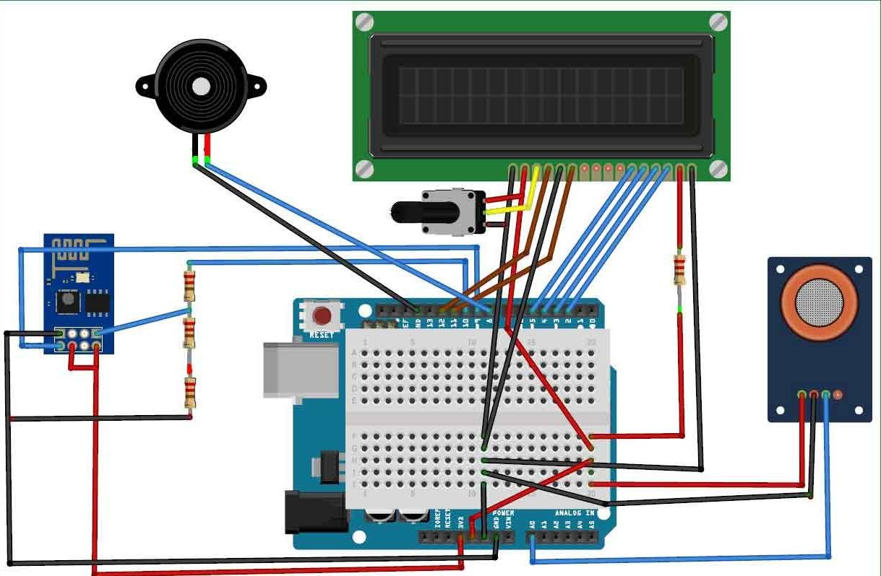
1.6 DESIGNATING WITH SOFTWARE
1. First Device

Slide 9
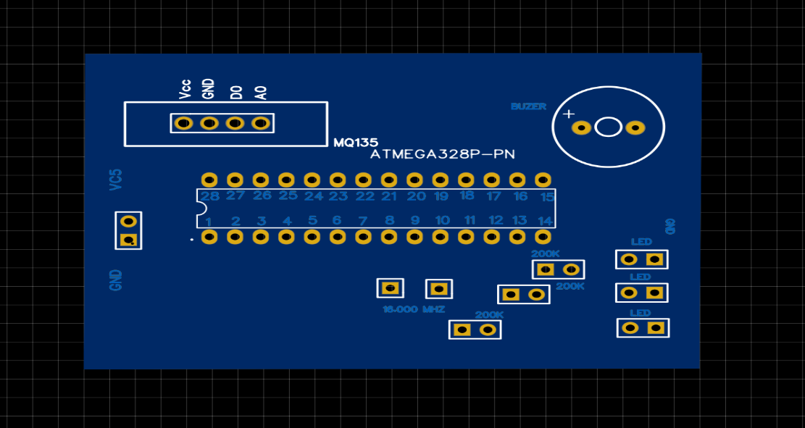
2. Second device

Slide 10
1.7 DEVICE COST SPECIFICATION
Component | Quantity | Price | Configuration | Vendor
Arduino Uno | 1 | 600 | R3 | Krishna Electronics
MQ-135 Sensor | 1 | 120 | MQ-135 | Krishna Electronics
Jumper Wires | 40 | 40 | Male To Male | Krishna Electronics
16x4 LCD display | 1 | 300 | 16*4 | Krishna Electronics
Breadboard | 1 | 60 |  | Krishna Electronics
Buzzer | 1 | 10 |  | Krishna Electronics
Atmega328p IC | 1 | 250 | 328P | Krishna Electronics
5V charging Module | 1 | 50 |  | Krishna Electronics
LED | 3 | 15 | R,Y,G | Krishna Electronics
200k Register | 3 | 6 |  | Krishna Electronics
16.000Mhz Crystal | 1 | 10 |  | Krishna Electronics
Coper Board | 1 | 90 |  | Krishna Electronics
Total |  | 1685 |  | Krishna Electronics

Slide 11
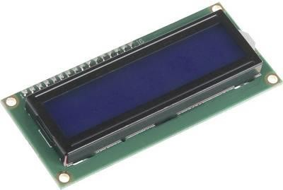
PHASE II:
ASSEMBLING AND PROGRAMMING IN VIRTUAL ENVIRONMENT
2.1 SELECTION OF THE HARDWARE COMPONENTS
16*4 LCD Display
The system displays the air quality on a 16x4 LCD display. It will show the air quality in PPM on the LCD so that we can monitor it very easily.

Slide 12
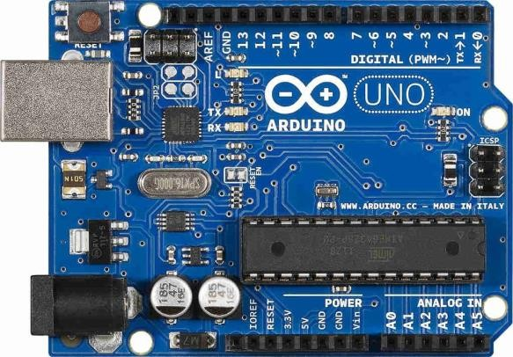
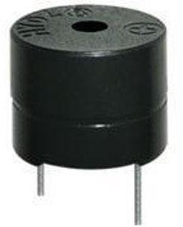
Arduino Uno
Buzzer
Focusing on the device produced, it detects high temperature and sense the dusty air immediately. Once the sensitivity is high, the buzzer module will active to alert user.

Slide 13
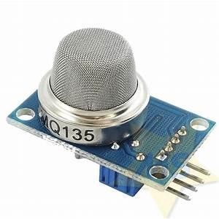
MQ-135 Sensor
This sensor is suitable for home and industrial use, it has fast response and recovery characteristics, long life and reliable stability.

Slide 14
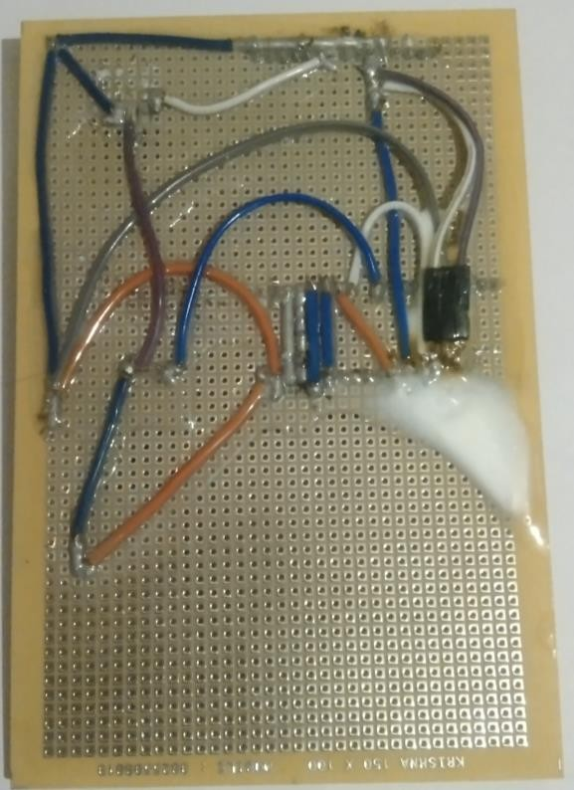
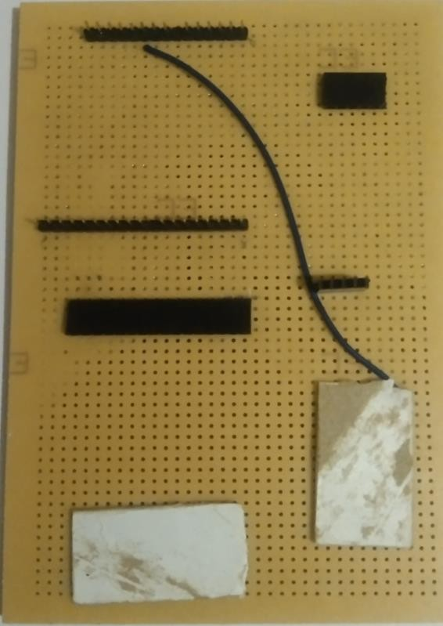
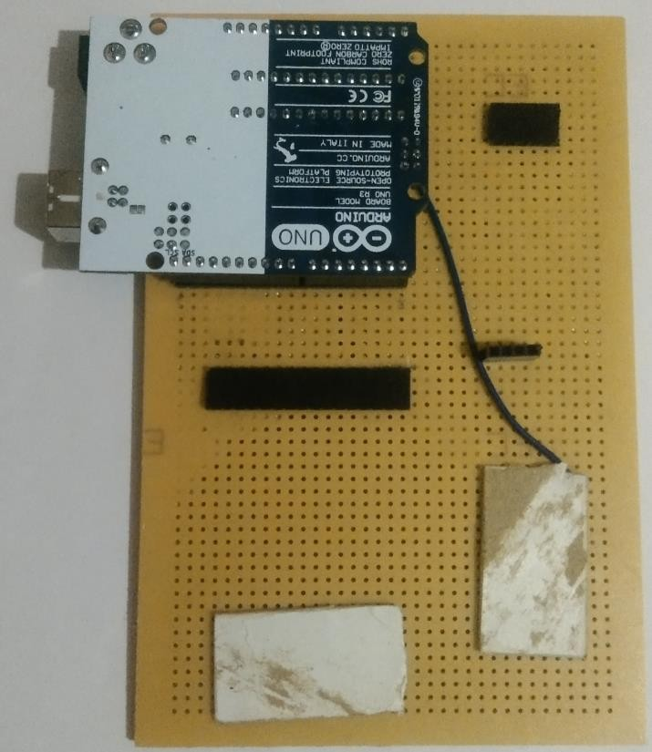
2.2 ESTABLISHING THE CONNECTIONS BETWEEN THE COMPONENTS
I. First Device
1. Circuit connection (Back Side)
2. Frint side
3. Arduino connection With Circuit

Slide 15
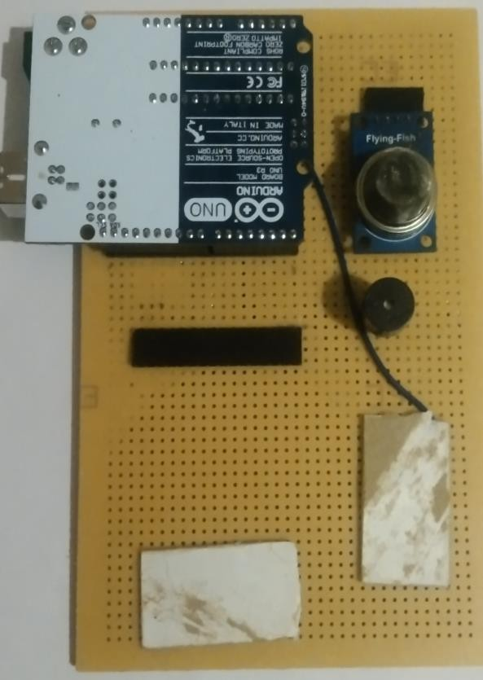
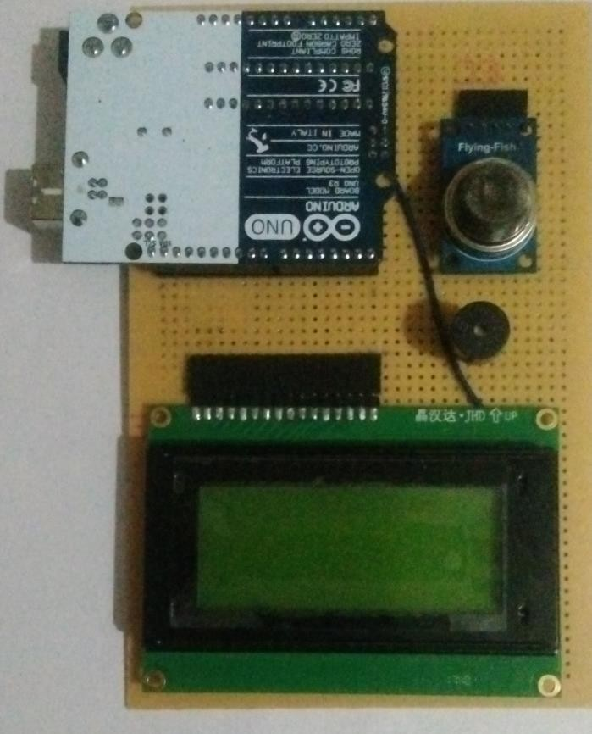
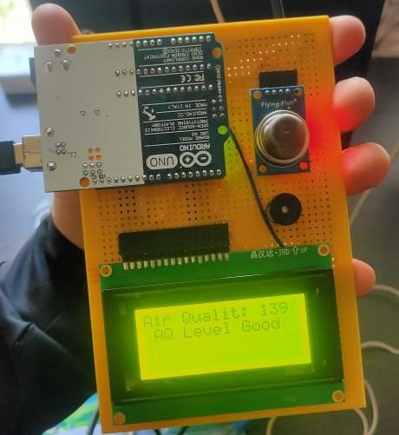
4.MQ-135 sensor and Buzzer connection with
5. Display connection with circuit
6.Working Module

Slide 16
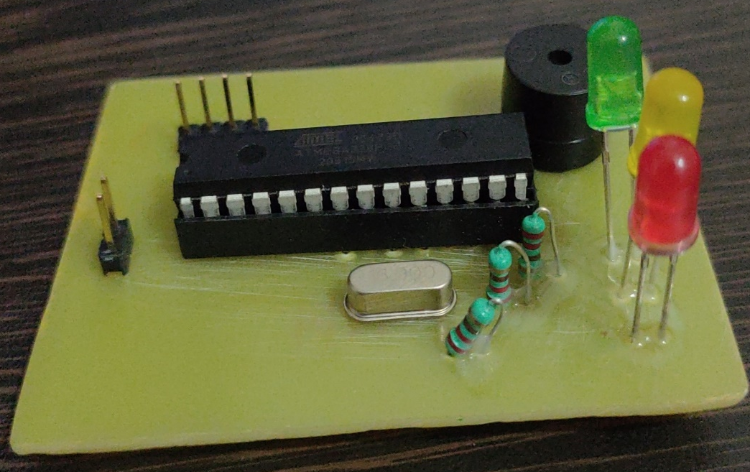
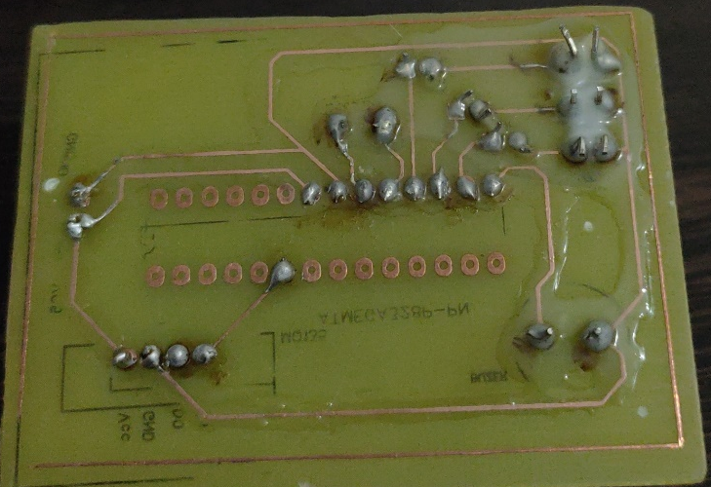
II. Second Device
Front Side
2. Back Side

Slide 17
2.3 DEVELOPING THE LOGIC
First Device Code
#include <LiquidCrystal.h>
const int rs=7, en=6, d4=5, d5=4, d6=3, d7=2;
LiquidCrystal lcd (rs,en,d4, d5,d6,d7);
//Header file for LCD
//pins of LCD connected to Arduino
//lcd function from LiquidCrystal
int buz = 8;
//buzzer connected to pin 8
const int aqsensor = A0; of Arduino
int threshold = 250;
//output of mq135 connected to A0 pin
//Threshold level for Air Quality
void setup() {
pinMode (buz,OUTPUT);
Arduino
pinMode (aqsensor,INPUT); arduino
// buzzer is connected as Output from
// MQ135 is connected as INPUT to
Serial.begin (9600);
rate of 9600
//begin serial communication with baud
lcd.clear();
lcd.begin (16,4);
// clear lcd
// consider 16,4 lcd
}
15

Slide 18
void loop() {
int ppm = analogRead(aqsensor); ppm
//read MQ135 analog outputs at A0 and store it in
Serial.print("Air Quality: "); Serial.println(ppm);
//print message in serail monitor
//print value of ppm in serial monitor
lcd.setCursor(0,0); lcd.print("Air Quality: "); lcd.print(ppm);
// set cursor of lcd to 1st row and 1st column
// print message on lcd
// print value of MQ135
If (ppm > threshold)
{
lcd.setCursor(1,1); lcd.print("AQ Level HIGH"); Serial.println("AQ Level HIGH"); digitalWrite(buz,HIGH);
}
Else
{
// check is ppm is greater than threshold or not
//jump here if ppm is greater than threshold
//Turn ON Buzzer
digitalWrite(buz,LOW); //Turn off Buzzer lcd.setCursor(1,1);
lcd.print ("AQ Level Good"); Serial.println("AQ Level Good");
}
delay (500);
}
18

Slide 19
II. Second Device Code
int buz = 8; //buzzer connected to pin 8
int green = 7; //led connected to pin 9
int yello = 6; //led connected to pin 9
int red = 5; //led connected to pin 9
const int aqsensor = A0; //output of mq135 connected to A0 pin of Arduino
int threshold = 230;//Threshold level for Air Quality
int threshold1 = 200;
void setup() {
pinMode (buz,OUTPUT); // buzzer is connected as Output from Arduino
pinMode (green,OUTPUT); // led is connected as output from Arduino
pinMode (yello,OUTPUT); // led is connected as output from Arduino
pinMode (red,OUTPUT); // led is connected as output from Arduino
pinMode (aqsensor,INPUT); // MQ135 is connected as INPUT to arduino
Serial.begin (9600); //begin serial communication with baud rate of 9600
}

Slide 20
void loop() {
int ppm = analogRead(aqsensor); //read MQ135 analog outputs at A0 and store it in ppm
Serial.print("Air Quality: "); //print message in serail monitor
Serial.println(ppm); //print value of ppm in serial monitor
if (ppm > threshold) // check is ppm is greater than threshold or not
{
Serial.println("AQ Level HIGH");
tone(red,1000,200); //blink led with turn on time 1000mS, turn off time 200mS
digitalWrite(green,LOW);
digitalWrite(yello,LOW);
digitalWrite(buz,HIGH); //Turn ON Buzzer
}
else if (ppm < threshold) // check is ppm is greater than threshold or not
{
if (ppm <= threshold1) // check is ppm lower than or = threshold1
{
Serial.println("AQ Level good");

Slide 21
tone(green,1000,200); //blink led with turn on time 1000mS, turn off time 200mS
digitalWrite(yello,LOW);
digitalWrite(red,LOW);
digitalWrite(buz,LOW);
}
Serial.println("AQ Level medium");
tone(yello,1000,200); //blink led with turn on time 1000mS, turn off time 200mS
digitalWrite(green,LOW);
digitalWrite(red,LOW);
digitalWrite(buz,LOW);
}
else
{
Serial.println("AQ Level Good");
digitalWrite(green,HIGH);
digitalWrite(yello,LOW);
digitalWrite(red,LOW);
digitalWrite(buz,LOW);
}
delay (500);
}

Slide 22
2.4 BURNING THE CODE INTO THE PROCESSOR
Connect your Arduino using the USB cable.
Choose Tools→Board→Arduino Uno to find your board in the Arduino menu.
Choose the correct serial port for your board.
Click the Upload button.
22

Slide 23
PHASE III: DEMONSTRATING ON THE KIT
3.1 OPTIMIZING THE COMPONENTS
The biggest problem with connecting components is when connecting the wires between them in the
right places.
The most important thing was to make this device smaller so that its size can be reduced and it can be more effectively carried by anyone anywhere and can be disabled or enabled anywhere.
Creating this device is the most common problem is a connecting each wire with a soldering so that soldering work is a most complicated and a time consuming work
The most serious thing when making this device was that if we put a single wire in the wrong place, there
could be a problem with the components of our equipment, which could cost our equipment more.
23

Slide 24
3.2 DETAIL UNDERSTANDING THE HARDWARE COMPONENTS ON PCB
This devise is Portable.
It is easy to implement any place.
This device gives output to current situation and current place
We can disassemble and add any element of this device at any place
24

Slide 25
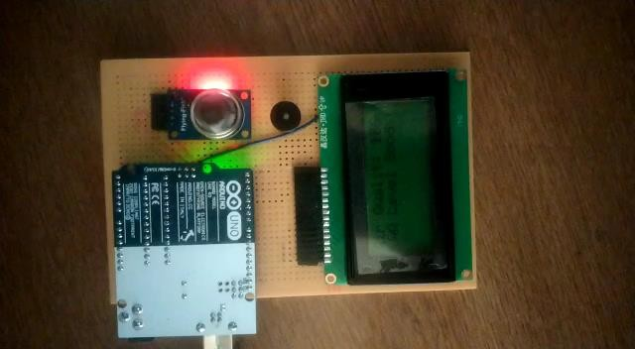
3.3 IMPLEMENTATION OF THE PROJECT
25

Slide 26
3.4 ADVANTAGES
Thus, installing an air quality monitoring system helps monitor the presence of pollutants, resulting in better environmental conditions for humans to reside.
This also impacts their health and reduces the chances of occurring any health issues by maintaining a moderate ambiance or as required.
Monitoring helps in assessing the level of pollution in relation to the ambient air quality standards.
Standards are a regulatory measure to set the target for pollution reduction and achieve clean air.
26

Slide 27
3.5 CHALLENGES
The main problem to build this device was to find a compatible sensor for that device.
The second main challenge is a connecting a circuit with a correct pin
Main challenge of this device is a make this device portable for everyone
The most important thing was to make this device smaller so that its size can be reduced and it can be more effectively carried by anyone anywhere and can be disabled or enabled anywhere.
27

Slide 28
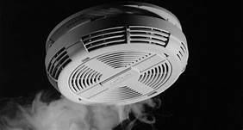
3.6 REAL LIFE APPLICATIONS
Smock Detector
Smoke sensors detect the presence of Smoke, Gases and Flame surrounding their field.
It can be detected either optically or by the physical process or by the use of both the methods
28

Slide 29
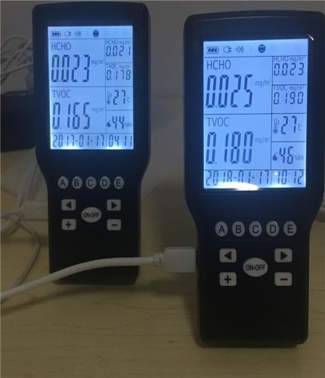
Air Pollution detector
The air pollution monitoring system was designed to monitor and analyse air quality in real-time and log data to a remote server, keeping the data updated over the internet.
Air quality measurements were taken based on the Parts per Million (PPM) metrics and analysed using Microsoft Excel.
29

Slide 30
3.7 CONCLUSION
This Air quality detector is devices that monitor the presence of air pollution and LPG GAS or Smock detector in the surrounding area.
This device will be able to work in all three conditions
30

Slide 31
3.8 REFERENCES
To make this device we got a reference from online websites and Youtube.com platform.
Link of the Website :- https://circuitdigest.com/arduino-projects
Link of the similar project :-
https://circuitdigest.com/microcontroller-projects/interfacing-mql35-gas-sensor- with-arduino-to-measure-co2-levels-in-ppm
31

